Slide 1

Federated Learning in Cybersecurity: Applications and Challenges
Beibei Li
Jan. 20, 2022
School of Cyber Science and Engineering, Sichuan University, P.R. China

Slide 2
01
Federated Learning
01
CONTENT
>>
Security Challenges in Federated Learning
02
Federated Learning Application in Cybersecurity

Slide 3
Federated Learning:
A new distributed learning paradigm
Introduce the concept of Federated Learning. Its development and current research topics about it.
Notes:
We’ll first explore the security Challenges in Federated Learning: Byzantine attack and its defense
The paper I introduced is “FLPhish: Reputation-based Phishing Byzantine Defense in Ensemble Federated Learning”, which is published in IEEE ISCC’2021. And this paper is awarded “Best Paper Award” in this conference.

Slide 4





Background of FL
For person:
People worry about the privacy leakage of their own data, which may result in possible financial crisis.
For company:
Companies worry about their trade secrets leakage from their data.
For government:
Governments have published some laws or policies to protect the privacy of people and stop the companies from holding too much private data.
Each entity refuses to share its own private data, therefore making itself “Isolated Island”.
To break the dilemma of “Isolated Island”, the Federated Learning (called FL) emerged.

Slide 5
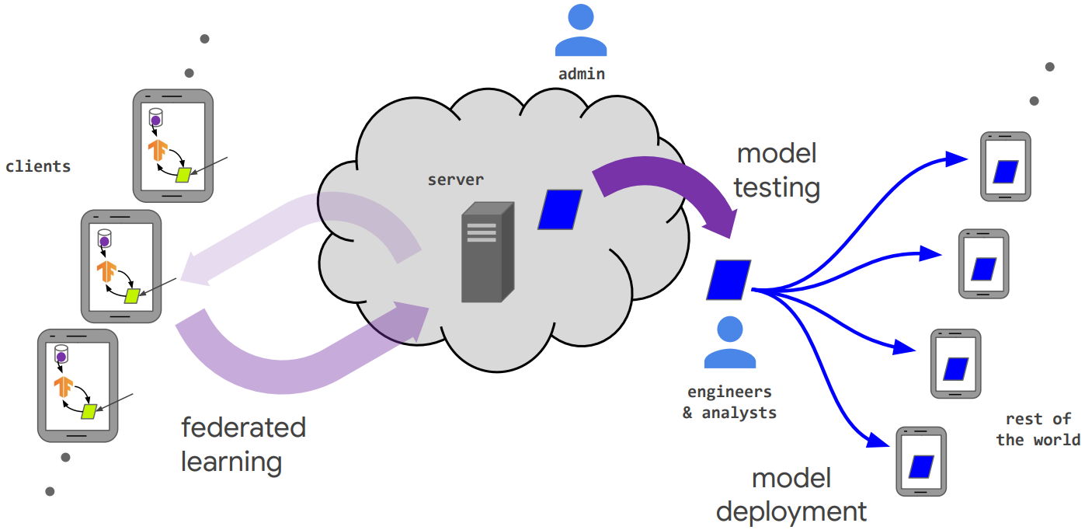
The First FL System
Google built the first Federated Learning system around the world in 2016, and applied the system on its phone application.

Slide 6
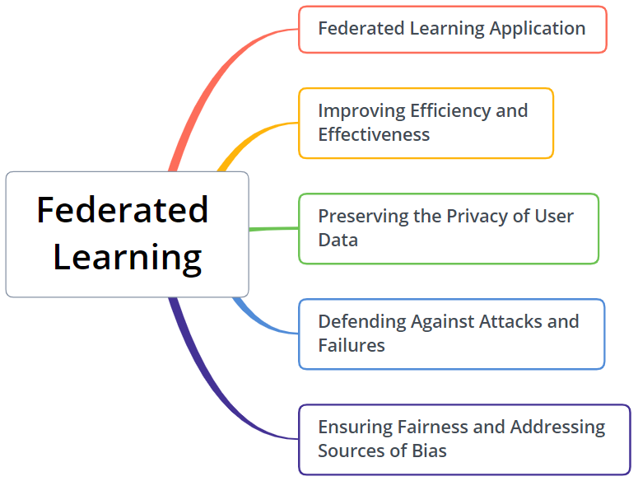
Research Topics about Federated Learning
Many researchers have started to conduct research about Federated Learning.
Federated Learning Application
Research on Federated Learning application in different industrial scenarios.
Improving Efficiency and Effectiveness
Research on how to improve the efficiency and effectiveness of Federated Learning.
Preserving the Privacy of User Data
Research on how to enhance the privacy of user data in Federated Learning.
Defending Against Attacks and Failures
Research on how to defend against attacks and failures in Federated Learning.
Ensuring Fairness and Addressing Sources of Bias
Research on how to ensure fairness and address sources of bias

Slide 7
Security Challenges in Federated Learning:
Byzantine Attack and Defense
FLPhish: Reputation-based Phishing Byzantine Defense in Ensemble Federated Learning
Best Paper Award in IEEE symposium on Computers and Communications (ISCC) 2021
Notes:
We’ll first explore the security Challenges in Federated Learning: Byzantine attack and its defense
The paper I introduced is “FLPhish: Reputation-based Phishing Byzantine Defense in Ensemble Federated Learning”, which is published in IEEE ISCC’2021. And this paper is awarded “Best Paper Award” in this conference.

Slide 8
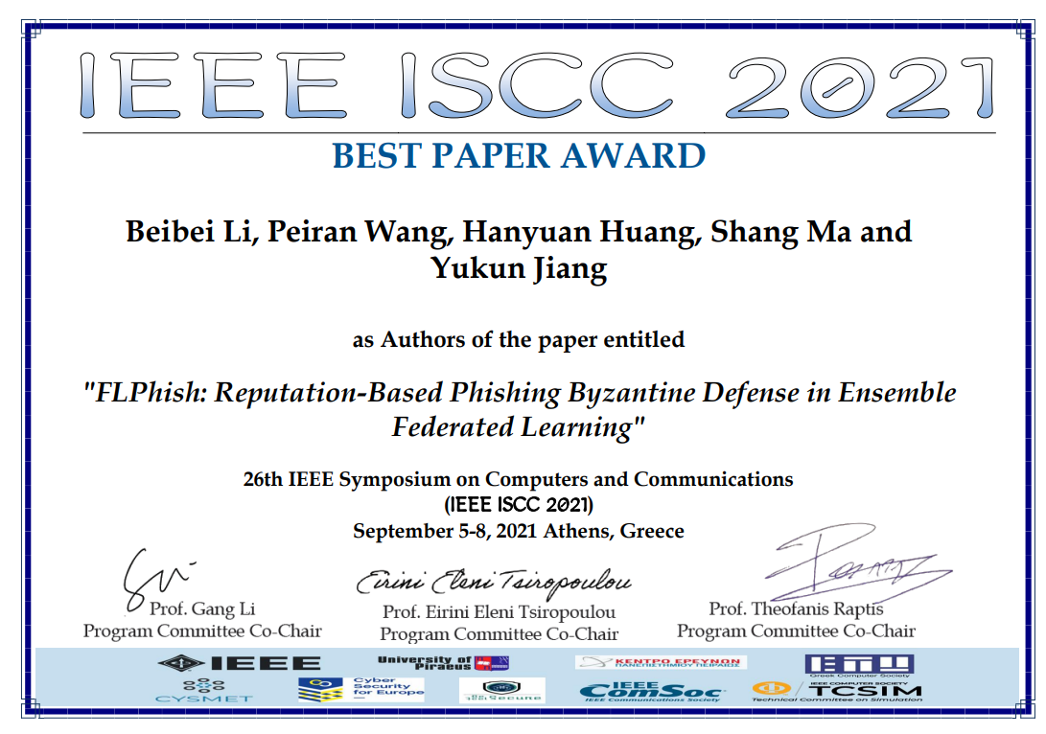
Best Paper Award in IEEE ISCC 2021

Slide 9
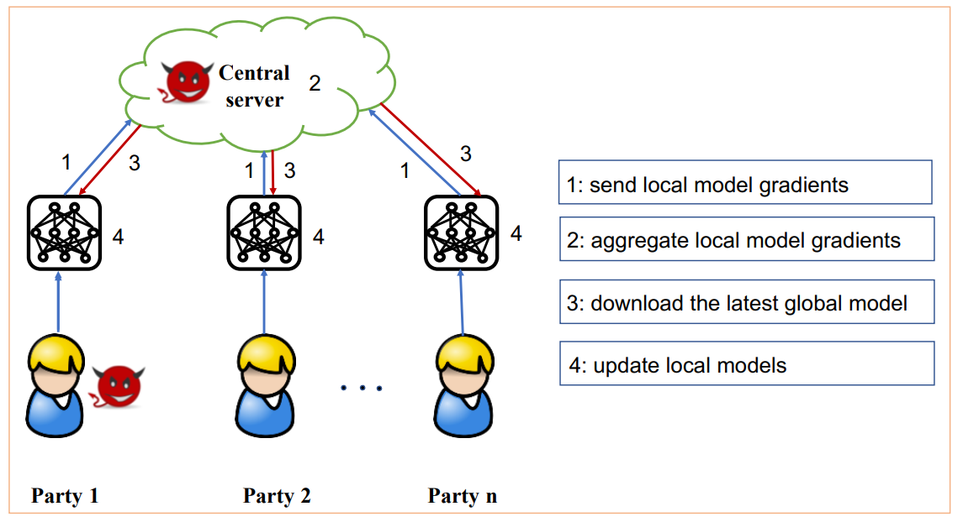
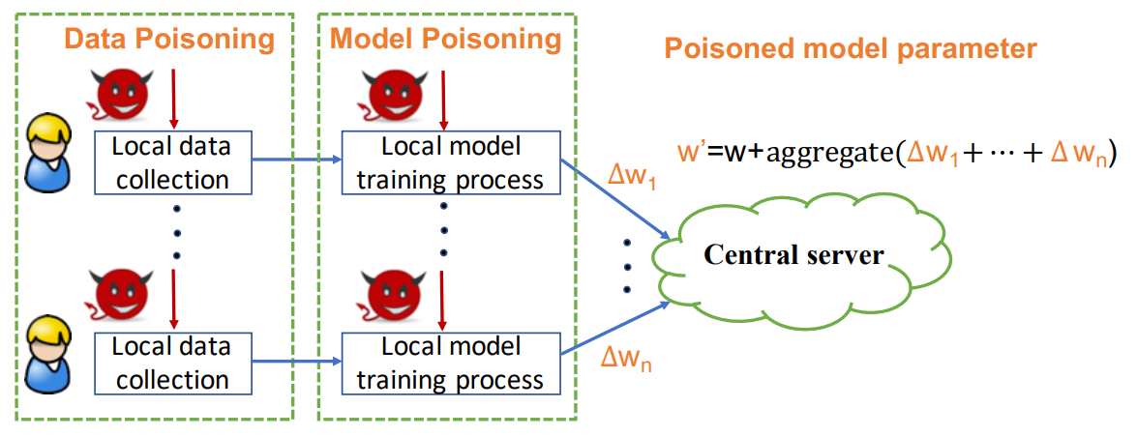
Ⅰ. Introduction
Typical Federated Learning (called FL) faces challenges from Byzantine attackers:
Malicious Byzantine attackers can launch attacks in two major way:
Data Poisoning Attack: Data poisoning attack is launched during local data collection by label flipping attacks etc.
Model Poisoning Attack: model poisoning attack is launched during local model training process
The intention of the attack is to violate central model
Lyu, Lingjuan, Han Yu, and Qiang Yang. "Threats to federated learning: A survey." arXiv preprint arXiv:2003.02133 (2020).

Slide 10
Ⅰ. Introduction
Typical FL has many drawbacks:
Heavy network cost
Each FL client should use the same type of deep learning model, such as CNN, LSTM ...
Vulnerable to malicious Byzantine attacks
Lyu, Lingjuan, Han Yu, and Qiang Yang. "Threats to federated learning: A survey." arXiv preprint arXiv:2003.02133 (2020).

Slide 11
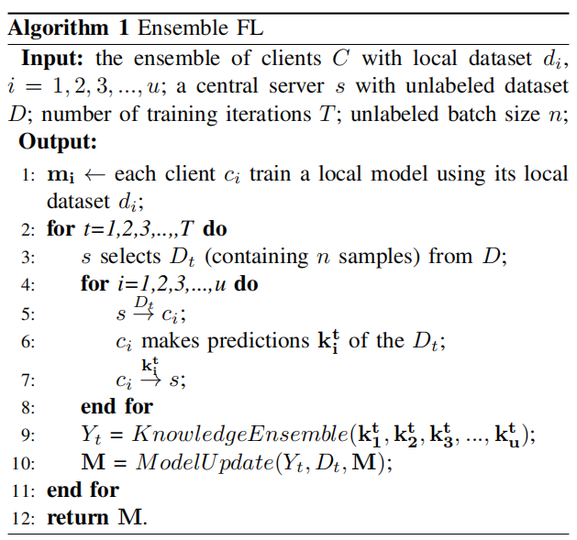


Ⅱ. Proposed FLPhish Scheme
FL Client:
Collect local data
Train a local model
Make predictions of the broadcast dataset
Transfer the predictions back to the FL server
FL Server:
Preserve a public dataset
Broadcast the public dataset
Receive the predictions of the public dataset
Aggregate the predictions of the public dataset
Notes:
First, we propose a new FL architecture, called Ensemble Federated Learning.
There are 2 types of entities in the Ensemble FL architecture:
FL Client:
Collect local data
Train a local model
Make predictions of the broadcast dataset
Transfer the predictions back to the FL server
FL Server:
Preserve a public dataset
Broadcast the public dataset
Receive the predictions of the public dataset
Aggregate the predictions of the public dataset
The whole process of Ensemble FL is shown as the right picture:
(Step-1: Local Model Training)
First, each client will use its dataset collected to train a local model. And The Byzantine attacker will train a poisoned model using a poisoned dataset.
(Step-2: Dataset Transferring)
Then, the central server transfers the public dataset which contains unlabeled dataset to the clients.
(Step-3: Label Predicting)
After receiving the public dataset, the client will make predictions of the public dataset using its local model. While if the client is a malicious Byzantine client, it will make wrong predictions about it. After the predicting, it will send the predictions to the central server.
(Step-4: Global Model Updating)
At last, the central server uses the rest of clients (no Byzantine client) to aggregate for a global predictions. And the central server will use the unlabeled dataset and the global predictions as the dataset’s label to update the global model.
As we can see, the security problem still exists in Ensemble FL.

Slide 12
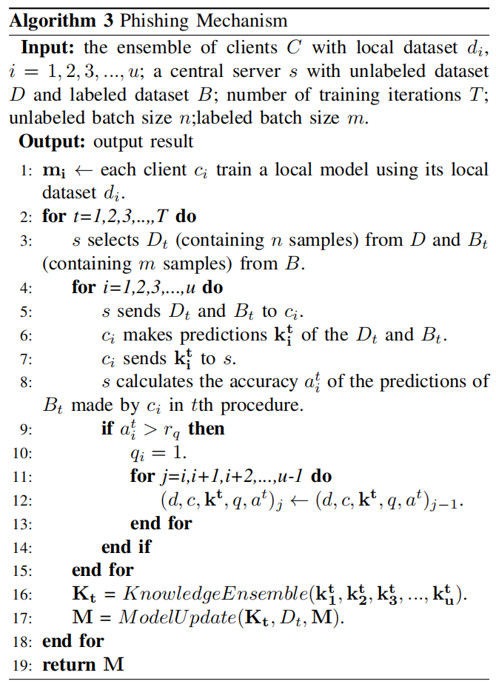













Ⅱ. Proposed FLPhish Scheme
Data Transmission:
Labels Transmission:
unlabeled
dataset
labeled
dataset
Byzantine Identifying
public dataset
central server
poisoned local model
poisoned knowledge
labels
malicious client
poisoned local dataset
predictions of labeled dataset
predictions of unlabeled dataset
predictions of labeled dataset
Notes:
To defend against Byzantine attack in our proposed Ensemble FL, we present a Byzantine defense scheme, FLPhish.
FLPhish’s process is shown as the following steps:
(Step-1: Local Model Training)
First, each client will use its dataset collected to train a local model.
(Step-2: Dataset Transferring)
Then, the central server transfers the public dataset which contains labeled dataset (it means that the central server has its correct label, and it is further referred as “bait”) `and unlabeled dataset to the clients.
(Step-3: Label Predicting)
After receiving the public dataset, the client will make predictions of the public dataset using its local model. While if the client is a malicious Byzantine client, it will make wrong predictions about it. After the predicting, it will send the predictions to the central server.
(Step-4: Byzantine Identifying)
The central server will use the labeled dataset’s label and the client’s prediction of the labeled dataset to calculate the client’s accuracy. Furthermore, the central server computes reputation for each client based on each round’s accuracy. After that, the central server will identify the client with reputation lower than threshold γ as Byzantine client.
(Step-5: Global Model Updating)
At last, the central server uses the rest of clients (no Byzantine client) to aggregate for a global update. And the global update is used to update the global model.

Slide 13
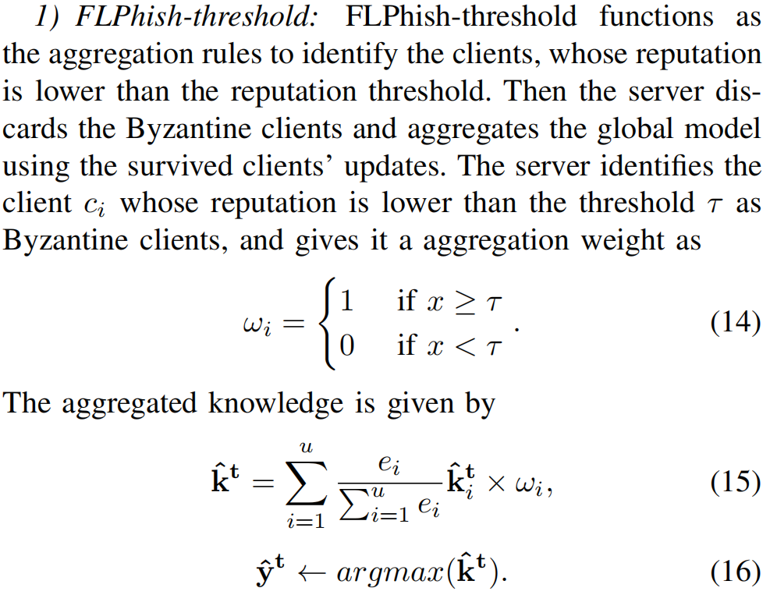
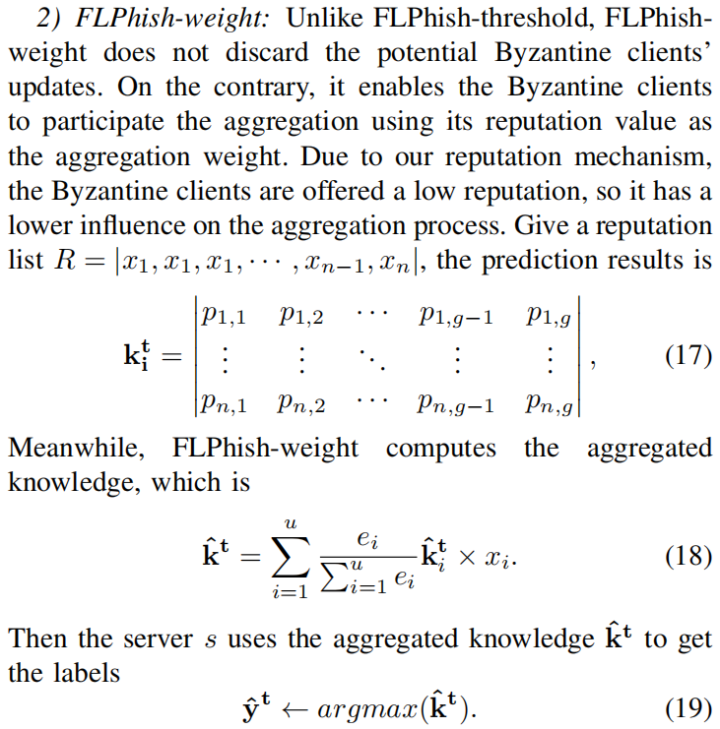
Ⅱ. Proposed FLPhish Scheme
Notes:
Furthermore, we proposed 2 aggregation rules in FLPhish:
FLPhish-threshold(proposed in conference):
In FLPhish-threshold, the central server identifies the client with its reputation value lower than the threshold as Byzantine client.
Furthermore, the central server discards the Byzantine client’ updates and aggregate all the other clients’ updates for a global update.
FLPhish-weight(proposed in journal):
In FLPhish-weight, the central server will use the reputation value of all the clients as their aggregation weight.
The Byzantine client will get a lower aggregation weight, thus making it unable to influence the aggregation.

Slide 14
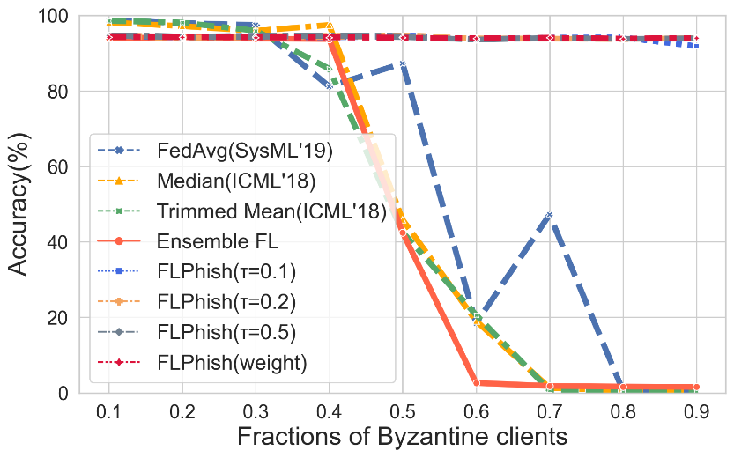
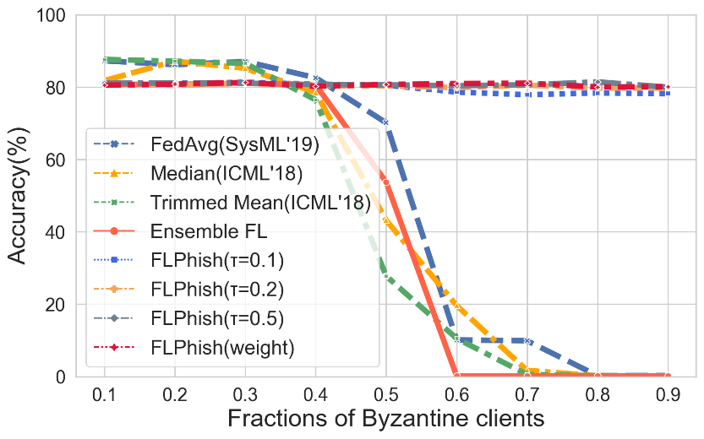
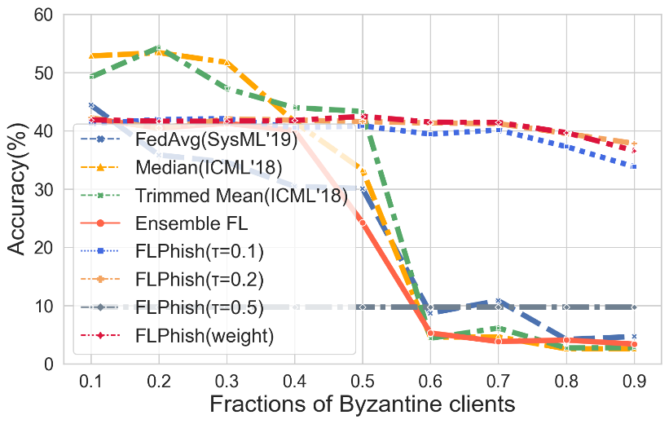
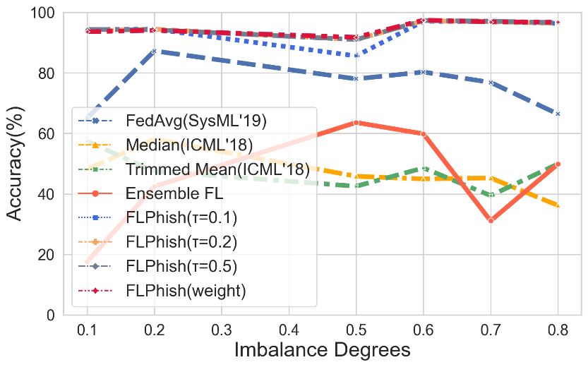
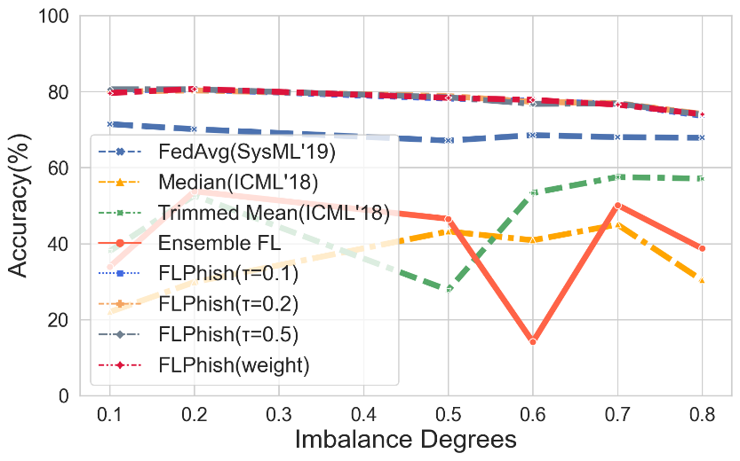
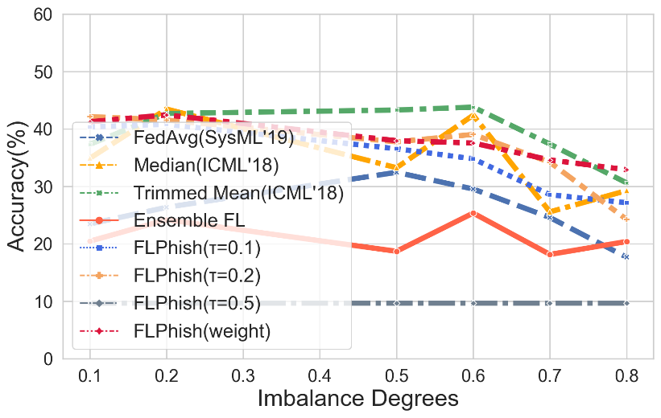
Ⅲ. Experiments Results
MNIST
Fashion-MNIST
CIFAR-10
Notes:
Furthermore, we compare our work with FedAvg, Median, and Trimmed Mean. FedAvg is proposed by Google in SysML. Trimmed Mean and Median is proposed by UC Berkely in ICML’18.
3 datasets, MNIST, Fashion-MNIST and CIFAR-10 are used in our experiments.
And we compare them under different imbalance degree of dataset (how much dataset’s distribution is non-iid, the plots in the left), and different fractions of Byzantine (the plots in the right).
The experiment results demonstrate that our FLPhish(both FLPhish-threshold and FLPhish-weight) framework outperforms FedAvg, Median and Trimmed Mean.
Furthermore, the experiments prove that FLPhish-weight(proposed in journal) is a more stable aggregation rule than FLPhish-threshold (proposed in conference).

Slide 15
Ⅳ. Conclusions
In this paper, we have designed an FL architecture, Ensemble Federated Learning in this study, which allows knowledge transferring between the FL server and FL clients via the unlabeled dataset and FL clients' predictions of it.
We have crafted the FLPhish technique to make Ensemble FL resistant to Byzantine attacks by using a labeled dataset as `bait' to detect malicious Byzantine clients.
Furthermore, we have proposed a reputation technique based on Bayesian inference to determine a client's level of trust.
We have also presented two aggregation techniques, FLPhish-threshold and FLPhish-weight, to improve FLPhish's performance.
At last, we have tested our suggested FLPhish in a variety of scenarios. The results of the experiment demonstrates the comparable performance of FLPhish in terms of accuracy and robustness under Byzantine attacks in FL.

Slide 16
Federated Learning Application in Cybersecurity:
Intrusion Detection in Industrial Cyber-Physical Systems
DeepFed: Federated Deep Learning for Intrusion Detection in Industrial Cyber–Physical Systems
ESI Highly Cited Paper, IEEE Transactions on Industrial Informatics

Slide 17
Ⅰ. Introduction
ICPSs: Industrial Cyber-Physical Systems (ICPSs) are large-scale, geographically dispersed, federated, heterogeneous, life-critical systems that comprise sensors, actuators, and control and networking components. These systems have multiple control loops, strict timing requirements, predictable network traffic, legacy components, and possibly wireless network segments.
Vulnerabilities of ICPSs: Many industries exist in ICPS with inherent security vulnerabilities can be exploited. It give a sophisticated adversary the possibility to launch attacks. If it is serious, it may cause the network of industries to immediately disrupt the concerned processes to a catastrophe.
Cause there are many threaten exist in ICPS, it is necessary to to do some research on intrusion detection in data privacy protection and multiple attack detection than ever before.
Notes:
e.g. Smart grids, unmanned aircraft systems.

Slide 18
Ⅰ. Introduction
Existing Problems in Intrusion Detection for ICPSs:
High quality and large quantities of training data are often hard to get and cannot be easily shared and transmitted.
The owner of some highly sensitive data will also strongly object to the unrestricted calculation and use of the data, in which case, the data owner will only allow the data to be kept in his own hands, thus creating separate islands of data.
Federated Learning:
Federated learning is a machine learning technique that trains an algorithm across multiple decentralized edge devices or servers holding local data samples, without exchanging their data samples.
Motivation of Federated Learning:
Machine learning or deep learning models can be trained by each data owner, then with the help of cloud server, a global model can be obtained through model aggregation.
If only parameters were transferred between the device and the the communication would be extremely efficient.
It can maximize the computing power of terminal devices in cloud systems.
Notes:
The process of exchanging model parameters between participants will be carefully designed so that third parties on communication channels and aggregated models cannot guess the private data content of any other organization.

Slide 19
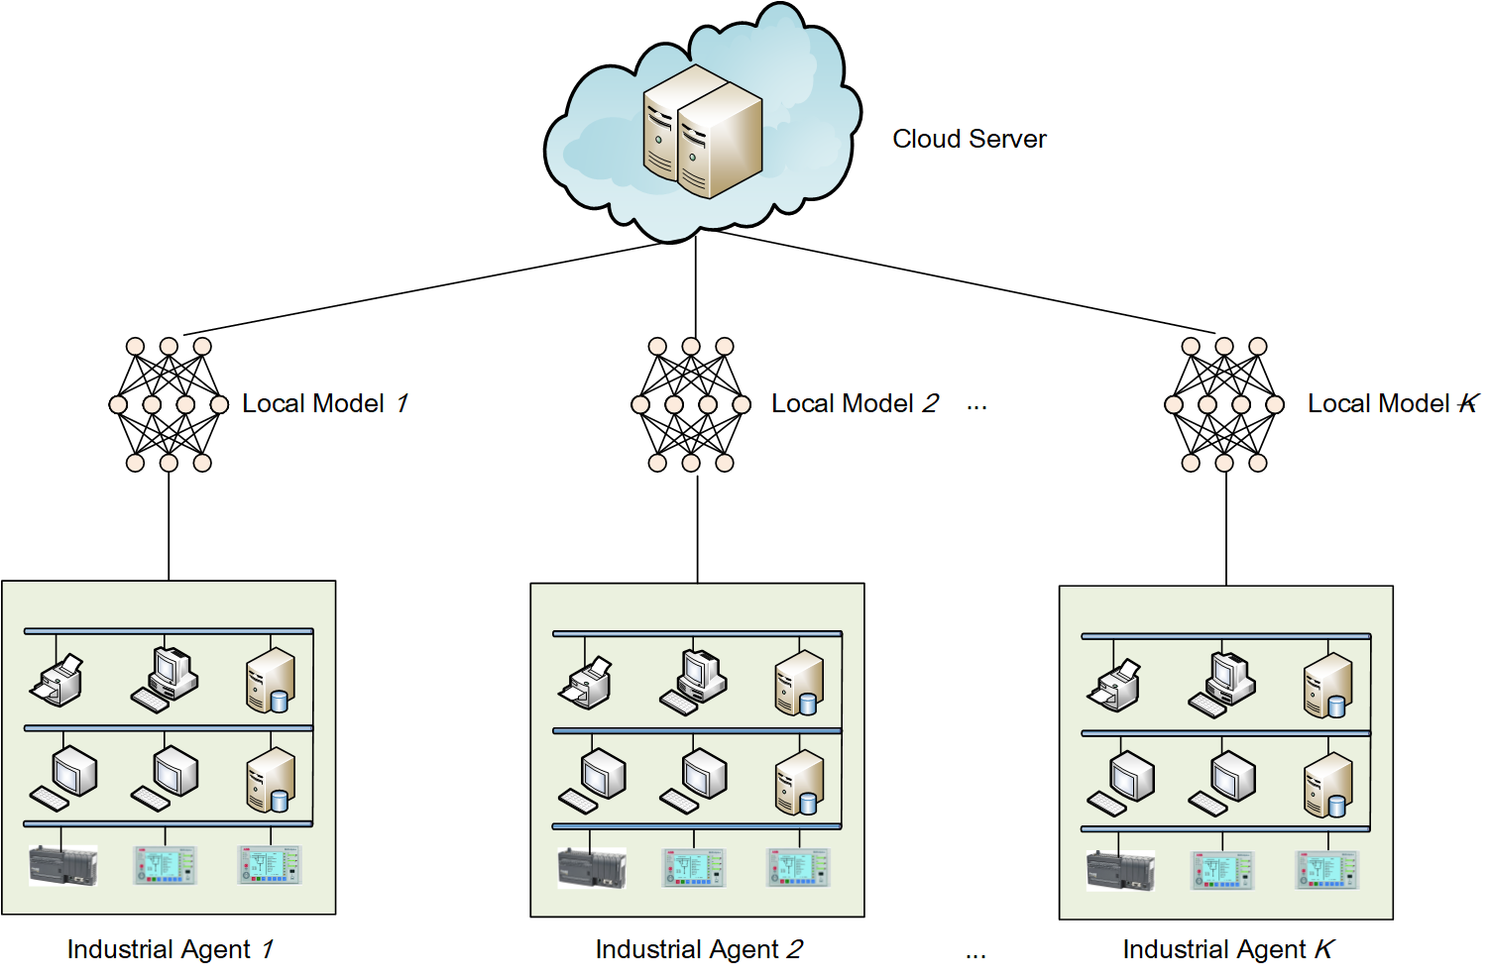
Ⅱ. System Model and Threat Model
A. System Model:
The considered system consist of k industrial agents and a cloud server.
Industrial agents, owners of ICPSs, with the same network traffic data structure that demand for collaboratively learning a deep learning model for intrusion detection .
A cloud server that aggregates intrusion detection models trained by industrial agents in the system.

Slide 20
Ⅱ. System Model and Threat Model
B. Threat Model:
Industrial agents are exposed to many severe threats:
Reconnaissance attacks
Response injection attacks
Command injection attacks
Denial-of service attacks
Threats during collaboratively model training:
Leakage of industrial agents’ data
Leakage of industrial agents’ model parameters
Assumptions:
All industrial agents are honest, so that agents follow the negotiated rules and they share the final model parameters. Since all industrial agents train models locally, there is no risk of industrial agents’ data leakage in the system.
The cloud server is semi-honest, namely honest but curious, in that it perform the actions correctly, but attempt to obtain model parameters of industrial agents. Hence, no leakage of parameters from any industrial agents to the server is allowed.

Slide 21
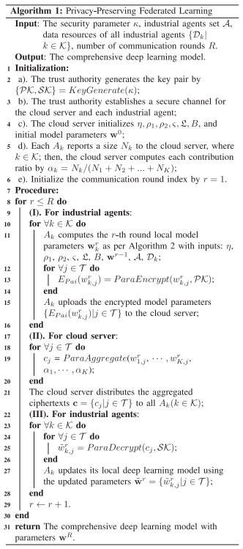
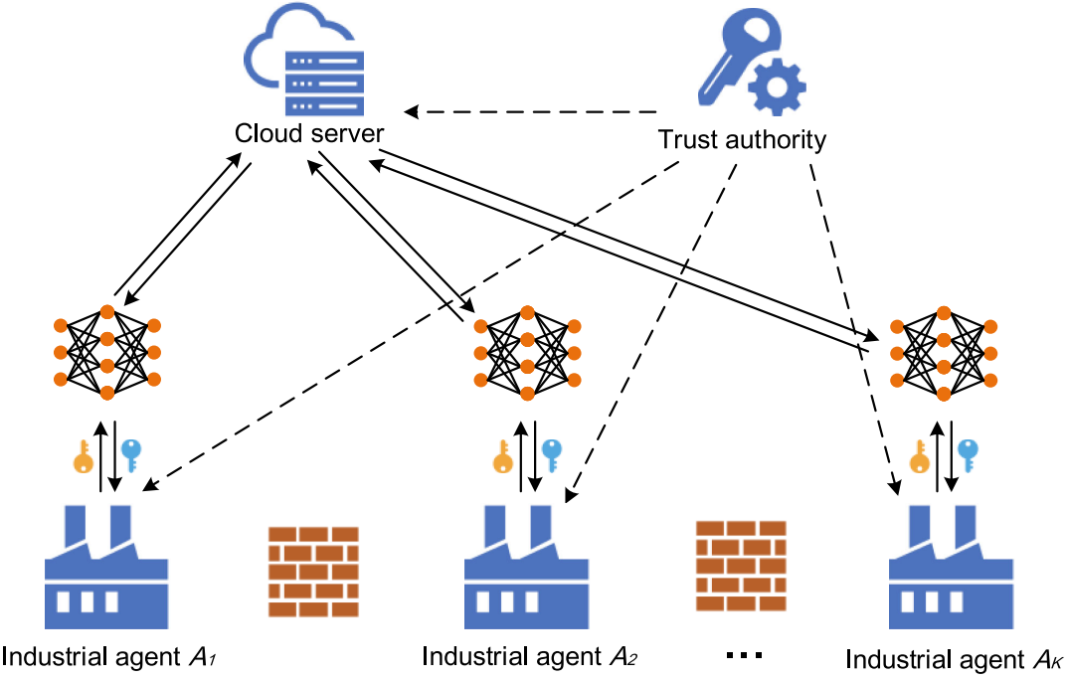
Ⅲ. The Proposed DeepFed Scheme
A. Framework of DeepFed:
Industrial agents jointly train a deep learning model for intrusion detection using federated learning.
Notes:
Industrial agents jointly train a deep learning model for intrusion detection using federated learning. The whole process is divided into communication rounds. Each communication round contains the following four steps:
Step 1: Locally train by industrial agents (homomorphic encryption: encrypt).
Step 2: Secure aggregated by server, a central model is obtained.
Step 3: Aggregated results are sent back to industrial agents.
Step 4: Respective models of industrial agents are updated (homomorphic encryption: decrypt).
Iterations until the loss function converges, thus completing the entire training process.

Slide 22
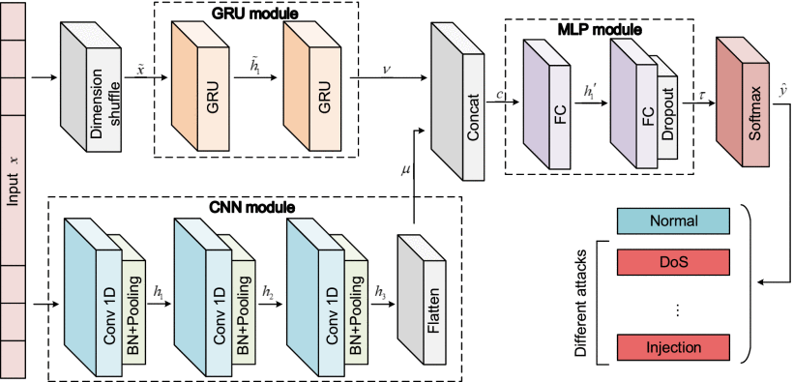
Ⅲ. The Proposed DeepFed Scheme
B. CNN-GRU Model for Intrusion Detection:
Model Architecture: The proposed CNN-GRU model is mainly composed by a CNN (convolutional neural network) module and a GRU (gated recurrent unit) module, followed by a MLP (multilayer perceptron) module, and then a softmax layer.

Slide 23
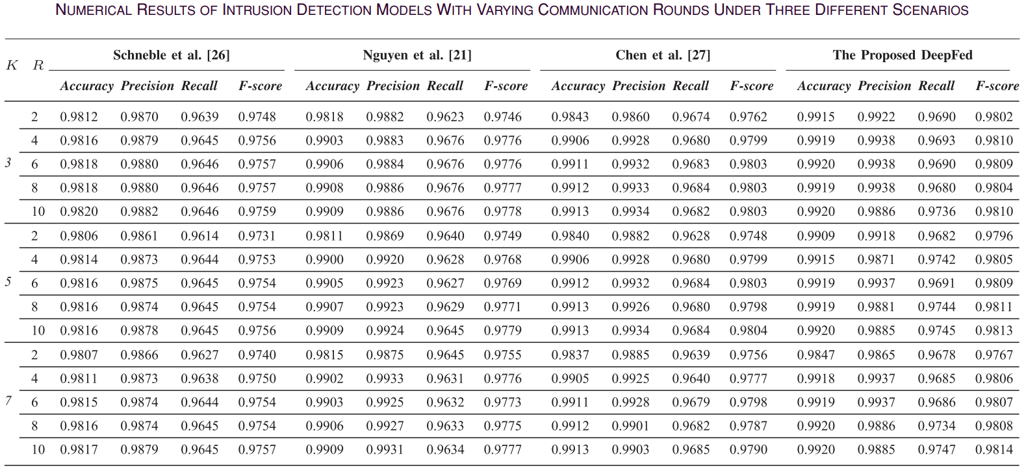
Ⅳ. Experiments and Evaluation
A. Performance Comparison with State-of-the-Art Studies: The performance of different models, including FL-MLP, FL-CNN,FL-GRU and FL-CNN-GRU, with different communication rounds under 3 different scenarios: 3 agents, 5 agents and 7 agents

Slide 24
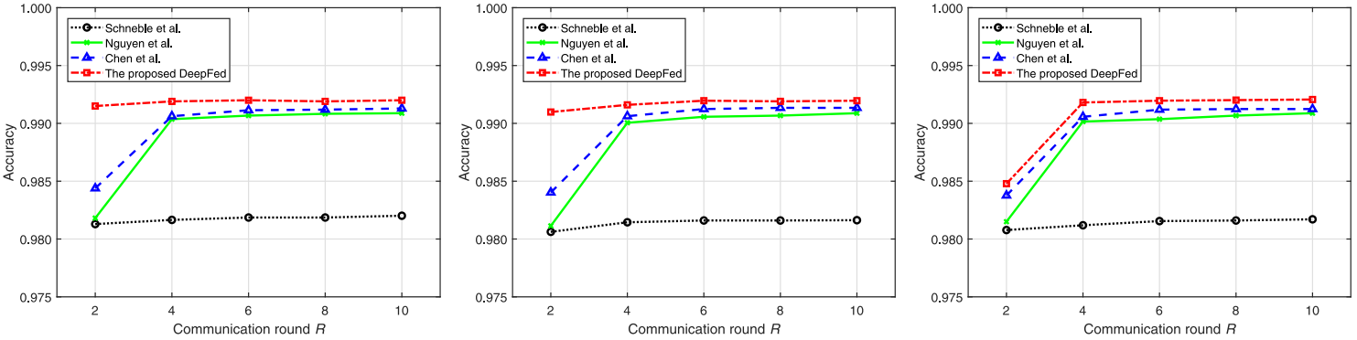
Ⅳ. Experiments and Evaluation
A. Performance Comparison with State-of-the-Art Studies: The accuracy of different models, including FL-MLP, FL-CNN,FL-GRU and FL-CNN-GRU, with different communication rounds under 3 different scenarios: 3 agents, 5 agents and 7 agents
3 agents
5 agents
7 agents

Slide 25
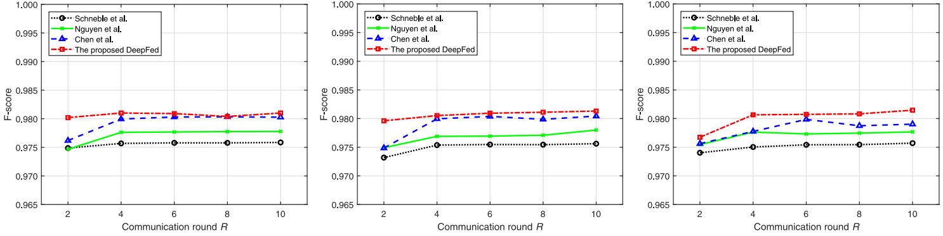
Ⅳ. Experiments and Evaluation
A. Performance Comparison with State-of-the-Art Studies: The F-score of different models, including FL-MLP, FL-CNN,FL-GRU and FL-CNN-GRU, with different communication rounds under 3 different scenarios: 3 agents, 5 agents and 7 agents
3 agents
5 agents
7 agents

Slide 26
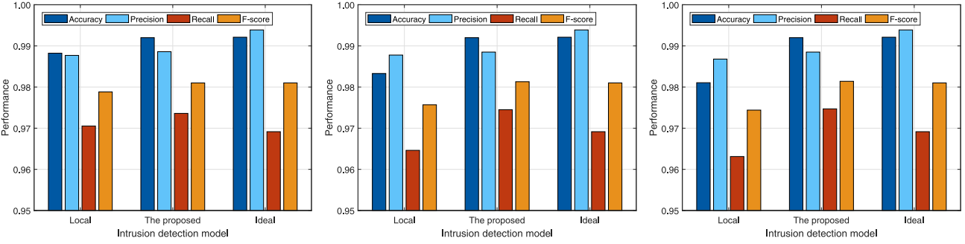
Ⅳ. Experiments and Evaluation
B. Performance comparison with local and ideal models: Performance comparison of local and ideal models under 3 different scenarios: 3 agents, 5 agents and 7 agents
3 agents
5 agents
7 agents

Slide 27
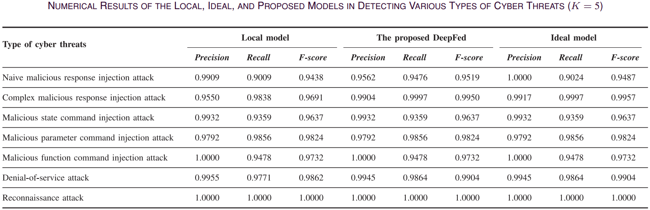
Ⅳ. Experiments and Evaluation
B. Performance comparison with local and ideal models: Performance comparison of local and ideal models in detecting various types of cyber threats

Slide 28
Ⅴ. Conclusion
First, a novel deep learning-based intrusion detection scheme, namely DeepFed is proposed for ICPSs, which can identify multiple attacks existing in ICPSs.
Second, federated learning is employed to jointly train a deep learning model with good performance that takes advantages of CNN and GRU. Meanwhile, data privacy of industrial agents can be protected during the collaborative training process.
Third, model parameters of all industrial agents are preserved by using homomorphic encryption, so that model parameter leakage can be avoided during the communication between industrial agents and cloud server.

Slide 29
Appreciation
Thank you for your listening
Beibei Li
Jan. 20, 2022
School of Cyber Science and Engineering, Sichuan University, P.R. China

